Slide 1


Gesture Controlled Robot
by,
Laxuman Pradhan (20120144)
Aiman Jalil (20120308)
Ashwin Bordoloi(20120392)
Under the guidance of
Mr. Saurav Paul
(Assistant Professor I ,SMIT)
SIKKIM MANIPAL INSTITUTE OF TECHNOLOGY
MAJITAR RANGPO, EAST SIKKIM 737136
12

Slide 2
CONTENTS
ABSTRACT
INTRODUCTION
LITERATURE SURVEY
PROBLEM DEFINITION
SOLUTION STRATEGY
IMPLEMENTAION FLOWCHART
WORK PROGRESS
PROGRESS TILL DATE
REFERENCES
11

Slide 3
ABSTRACT
Limit the usage of peripheral devices.
This can be done by interpreting hand gestures.
Recognize patterns, generate movements.
Give output to the robot.
Perform action.
10

Slide 4
INTRODUCTION
Using gestures to provide a more natural way of controlling robotic systems
Passage of data signals to robot using either an accelerometer or via image processing
Program compiled using an Arduino microcontroller
Image processed using MATLAB
9

Slide 5
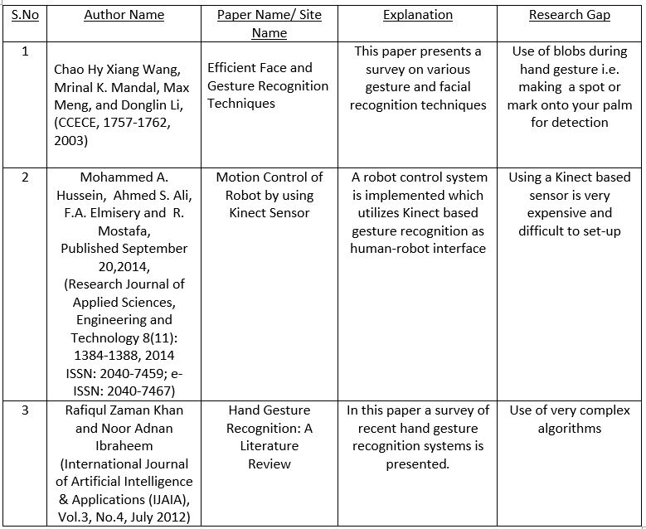
LITERATURE SURVEY
8

Slide 6
PROBLEM DEFINITION
High Cost of peripherals, associated with control of the Robot.
Maintaining a background database .
Hand gesture recognition using hand accessories/props .
7

Slide 7
SOLUTION STRATEGY
Capture images of gestures
Process Gesture input
Command Signal Generation
Navigation of Robot in specified direction
Passing Signal to Robot
Basic control flow of the system
6

Slide 8
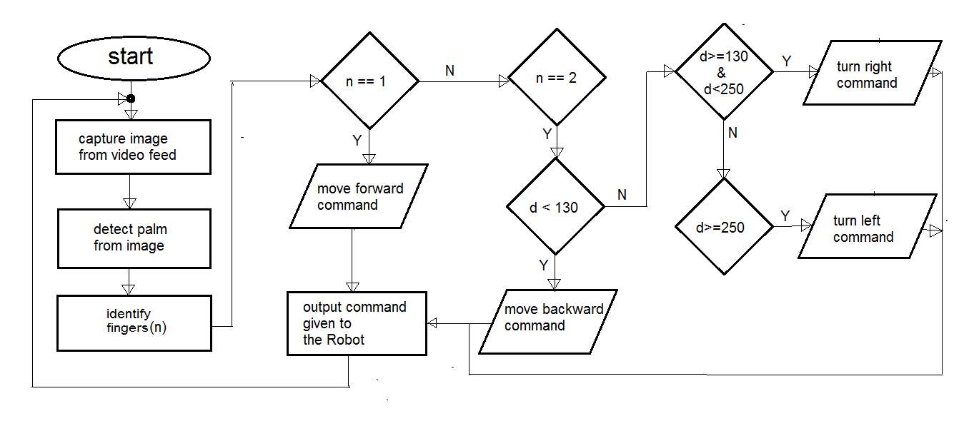
IMPLEMENTATION: FLOWCHART
5

Slide 9
PROGRESS TILL DATE
Hand palm recognition and counting of fingers.
recognizing different gestures
Sending final output command based on the gesture
Initial interfacing the MATLAB code with an Arduino micro-controller
Building the Robot
4

Slide 10
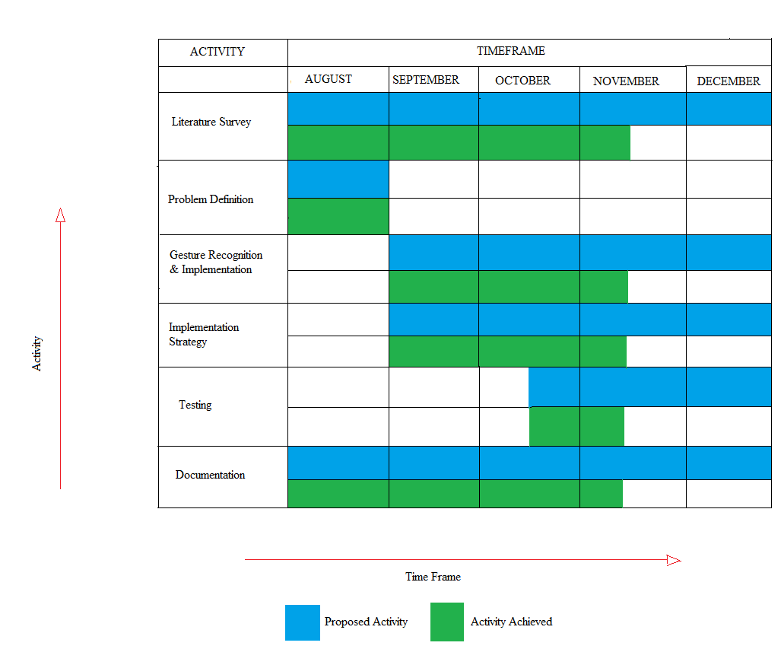
WORK PROGRESS
3

Slide 11
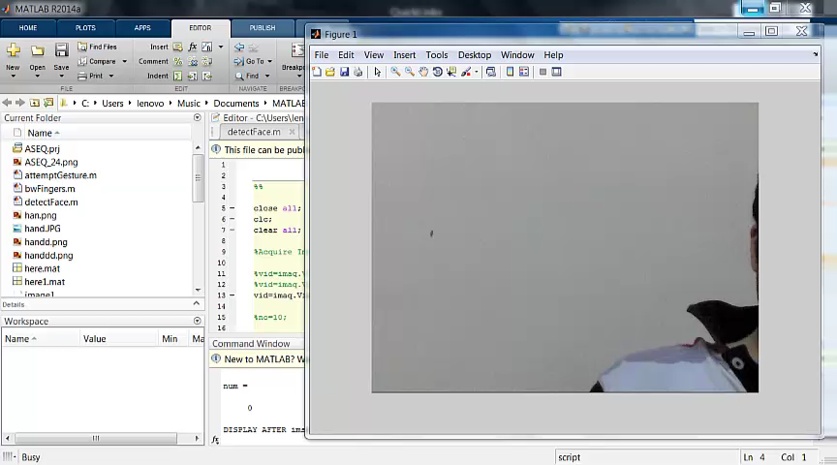
SCREENSHOTS
2

Slide 12
PROGRESS REMAINING
Final interfacing of the Robot with the Gesture Recognition Signals.
Induction of more Gesture Commands
4

Slide 13
REFERENCES
Efficient Face and Gesture Recognition Techniques- Paper by Chao Hy Xiang Wang, Mrinal K. Mandal, Max Meng, and Donglin Li, CCECE, 1757-1762, 2003
Motion Control of Robot by using Kinect Sensor- Paper by Mohammed A. Hussein, Ahmed S. Ali, F.A. Elmisery and R. Mostafa, September 2014
Hand Gesture Recognition: A Literature Review- Paper by Rafiqul Zaman Khan and Noor Adnan Ibraheem, July 2012
Arduino: http://www.arduino.cc/en/Guide/HomePage
AdruinoUno, http://arduino.cc/en/Main/arduinoBoardUno.
http://www.e-yantra.org/home/projects-wiki/item/180-gesture-controlled-robot-using-firebirdv-and-kinect
http://luckylarry.co.uk/arduino-projects/control-a-dc-motor-with-arduino-and-l293d-chip/
1

Slide 14
Thank You

